Slide 1

The Role and Evolution of Data Warehousing and OLAP in Modern Data Analytics
Presented by Hognogi Ana-Maria Cristina

Slide 2
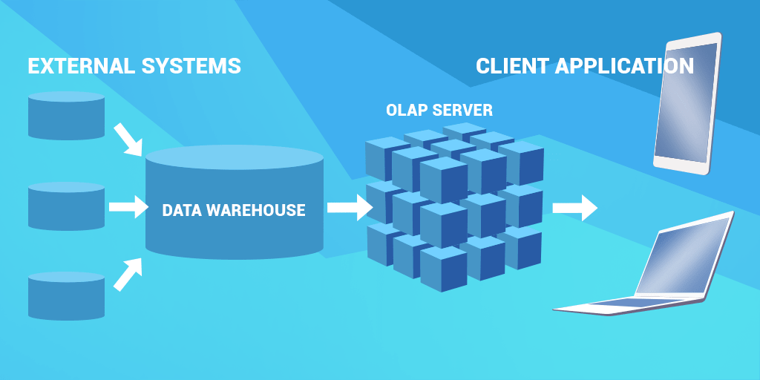
Introduction
Data is everywhere! Businesses need tools to manage and analyze it effectively. Data Warehousing stores data from multiple sources, while OLAP helps analyze it across dimensions, uncovering trends and insights.

Slide 3
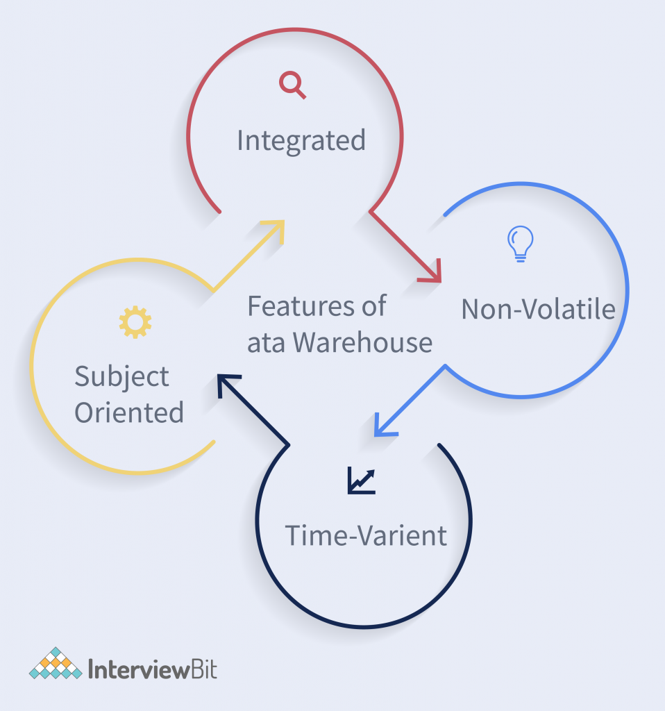
What Is a Data Warehouse?
A central library for data that’s subject-oriented, integrated, time-variant, and nonvolatile. It organizes information for long-term analysis and decision-making.

Slide 4
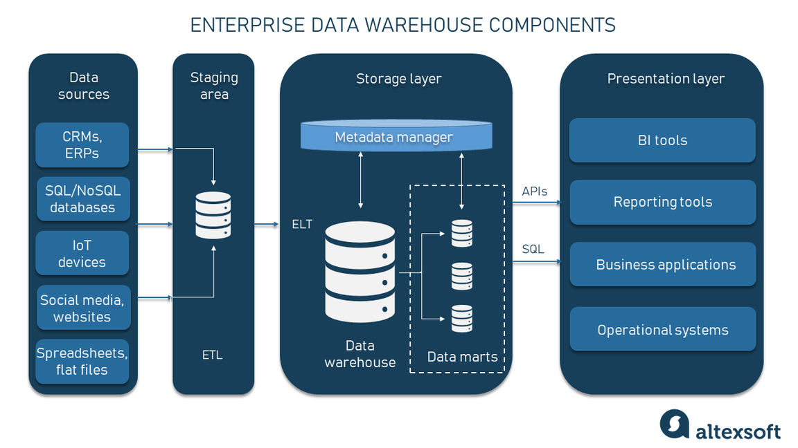
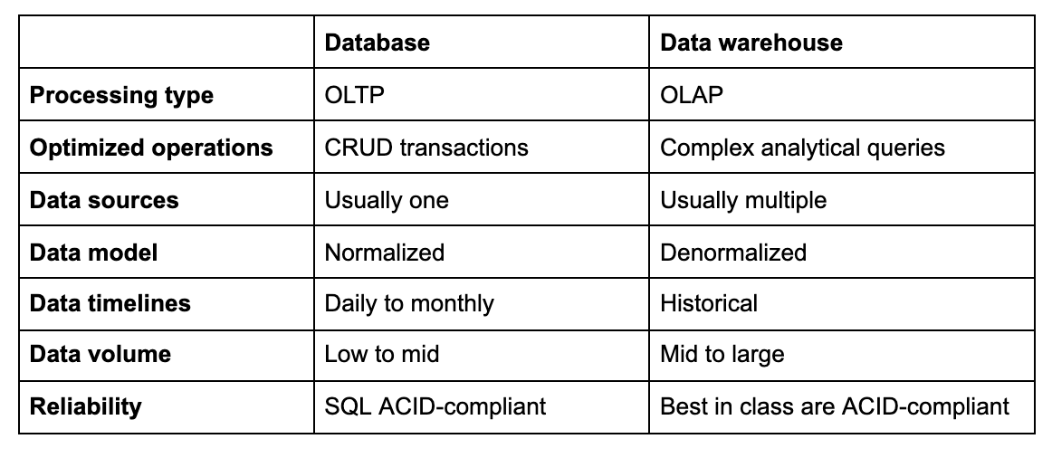
Data Warehouse Architecture
Four layers: data sources, ETL (cleaning and transforming), data storage (schemas like star and snowflake), and access tools (dashboards and queries).

Slide 5

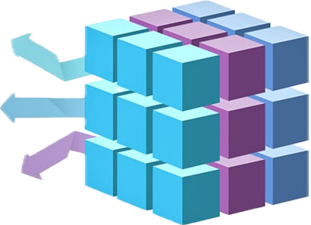
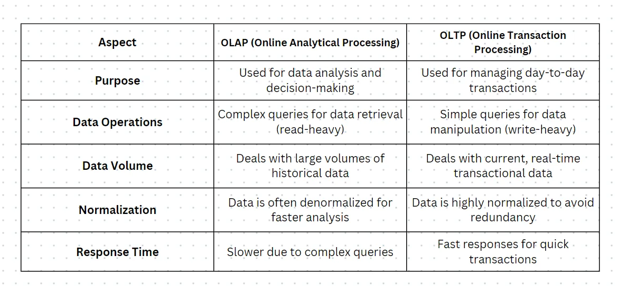
What Is OLAP?
OLAP organizes data in multidimensional 'cubes,' letting users explore it across perspectives like time, location, and product. It’s the key to interactive, real-time analysis.

Slide 6
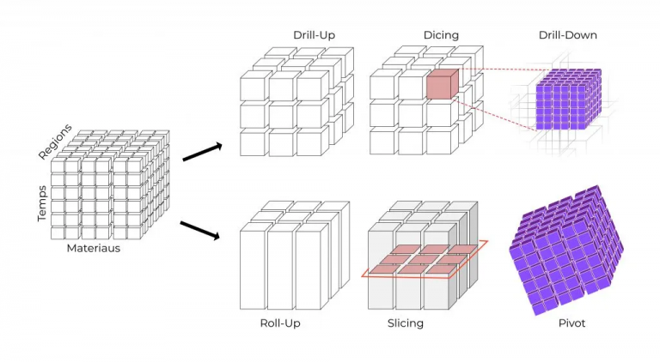
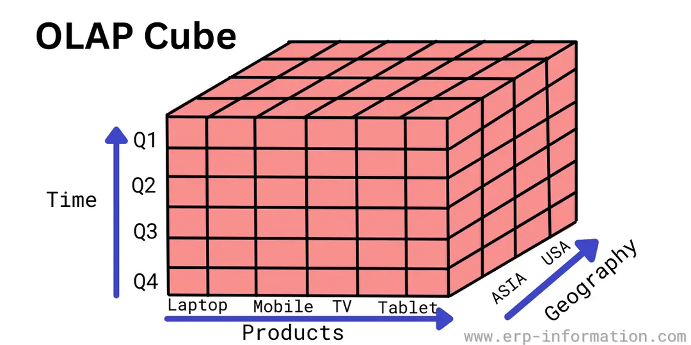
How Does OLAP Work?
Data is extracted from various sources and stored in the Data Warehouse. It is then cleaned, transformed, and organized into OLAP cubes, where it is pre-calculated and aggregated for analysis. Finally, users query the OLAP cubes to access the data.

Slide 7
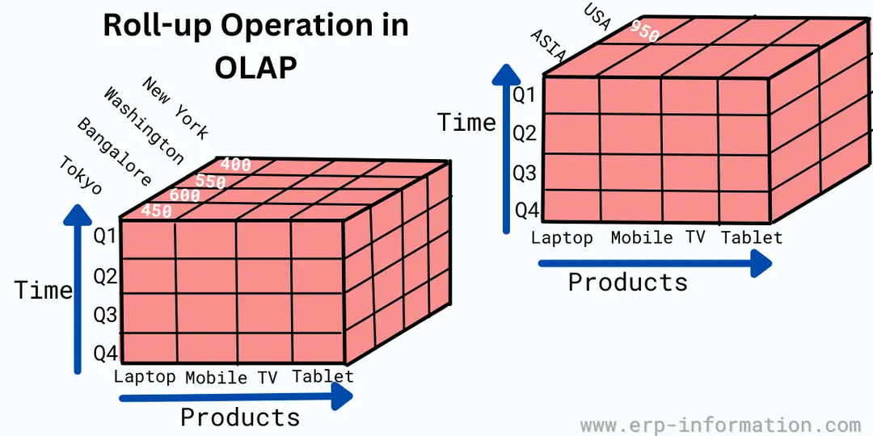
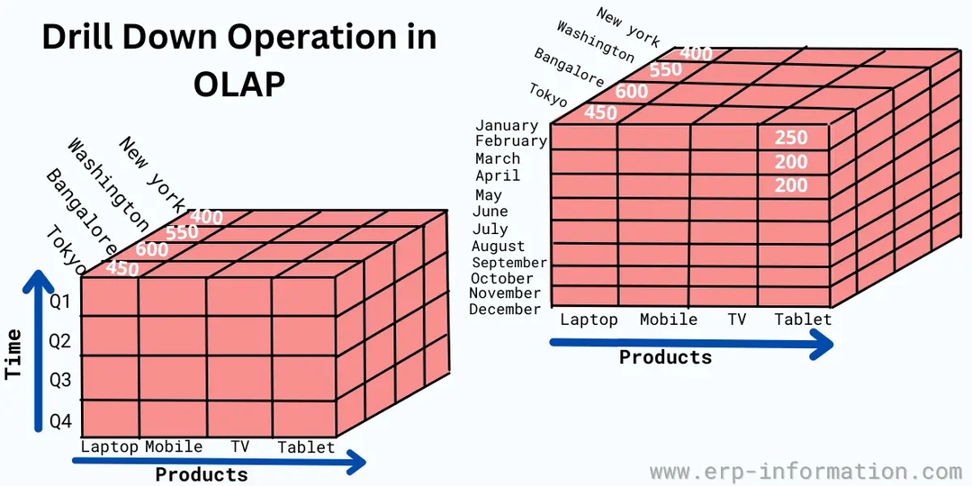
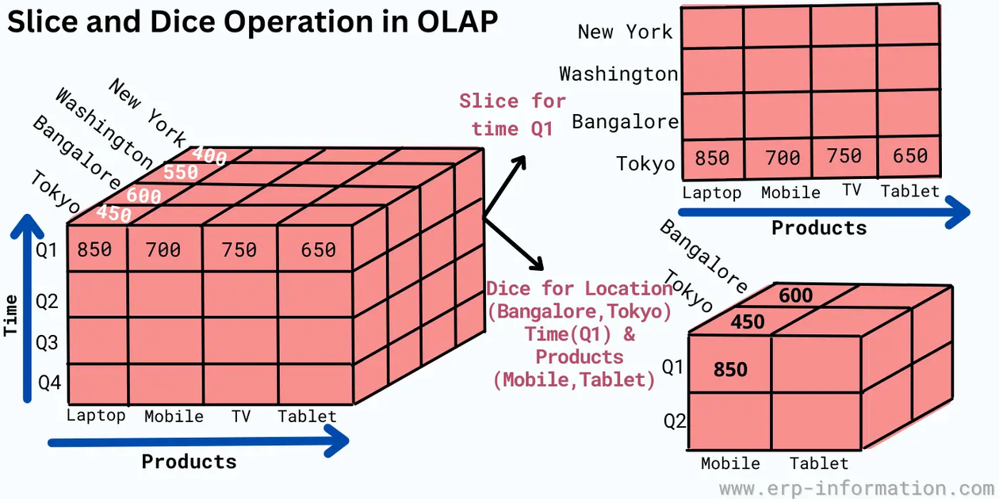
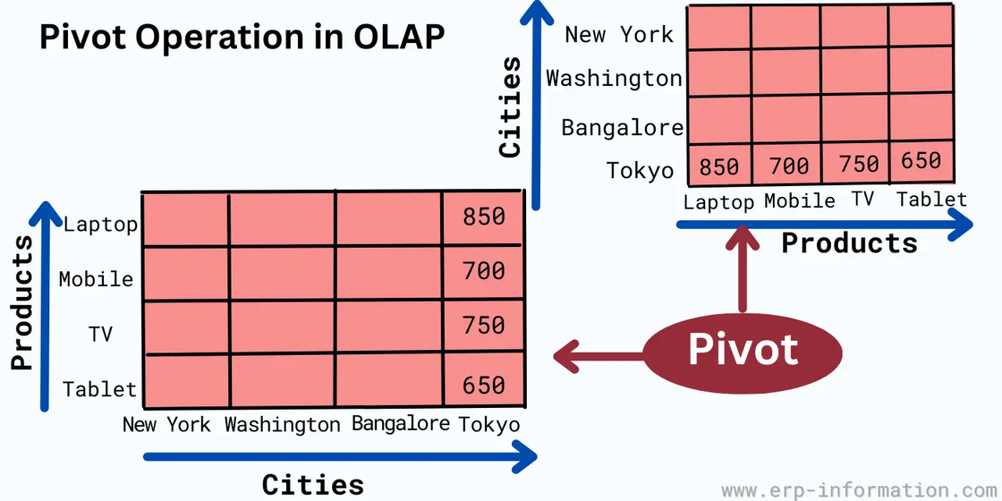

Slide 8

01
Retail: Track sales and promotions.
02
Healthcare: Monitor patient trends.
Applications of OLAP
03
Finance: Detect fraud.
04
Education: Analyze performance.

Slide 9
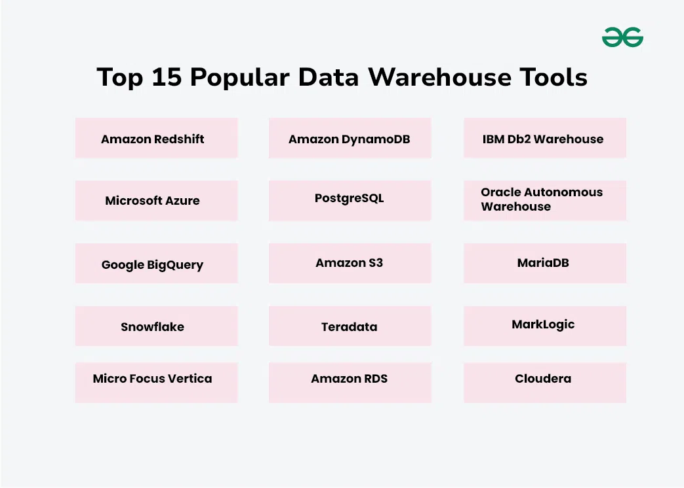

Slide 10
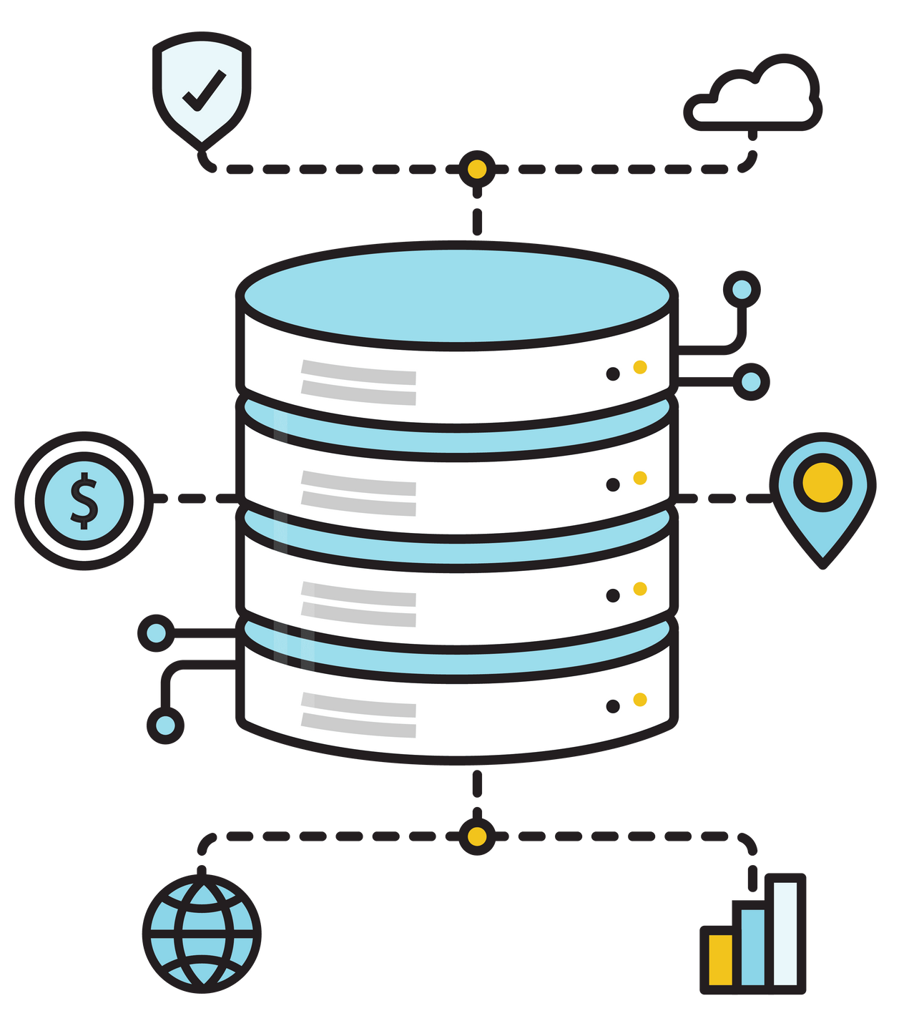
Resource page
https://ashutosh-bitmesra.medium.com/oltp-and-olap-what-are-the-differences-a6e21f25bfe0
https://www.keboola.com/blog/data-warehouse-vs-database
https://galaktika-soft.com/blog/olap-cubes.html
https://www.erp-information.com/online-analytical-processing.html
https://www.altexsoft.com/blog/enterprise-data-warehouse-concepts/

